Slide 1
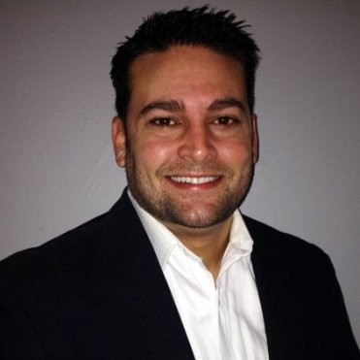
Effectively Handling Safety Risk Takers from a Management and Legal Perspective
Thank you for joining us, we will begin soon…
Jason Mozo, J. D.
Executive Director
JMozo@FlChamber.com
(850) 521-1237

Slide 2
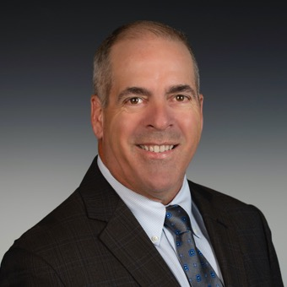
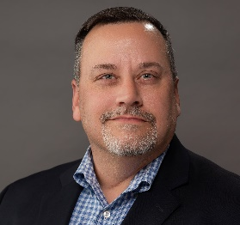
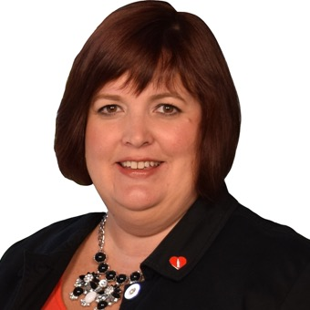
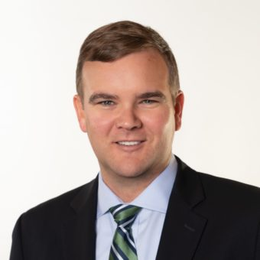
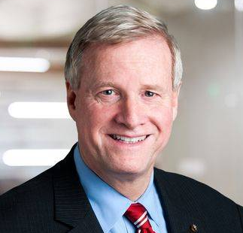
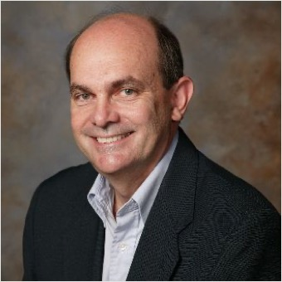
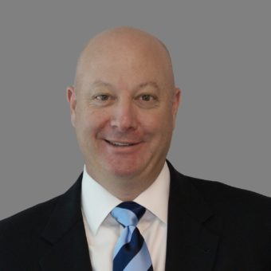
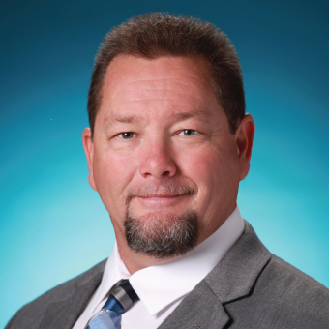
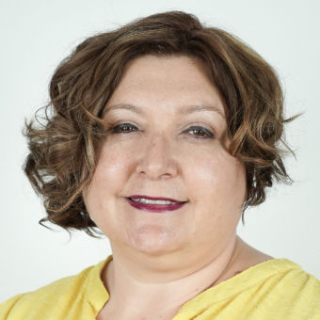
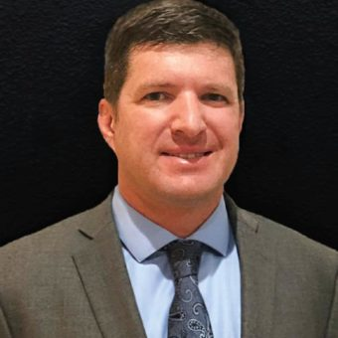
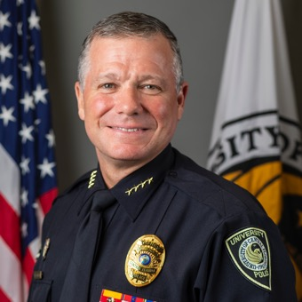
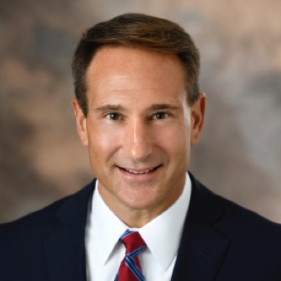
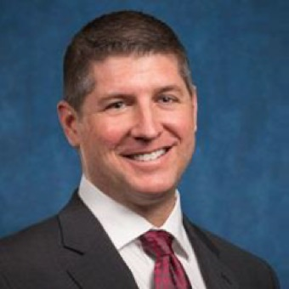
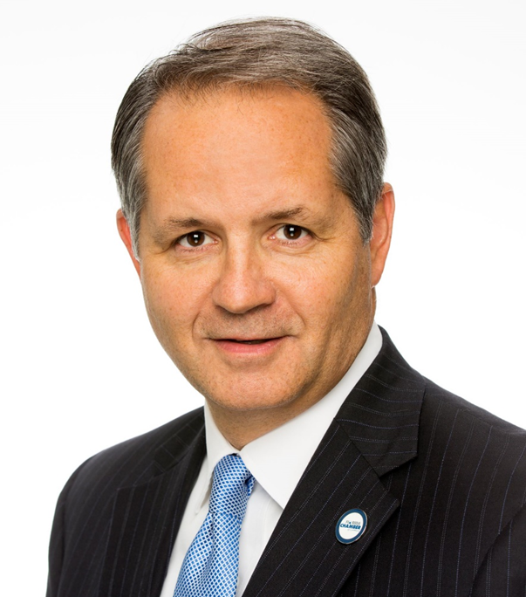
17 Advisory Board Members
Mark Morgan, Chair
NextEra Energy, Inc.
Tom Baldwin
Global Medical Response
Erin Black
Coca-Cola Florida
Dr. Josh Chard
Altec Industries
Matt Fisher
Pike Electric
Edwin G. Foulke, Jr.
Fisher Phillips
Scott Frazer
Boldt
Greg Hale
Walt Disney Parks & Resorts
Sandy Hodes
Ryder Systems, Inc.
Mark Ligon
Vecellio Group, Inc.
Jody McClure
ABC Fine Wine & Spirits
Greg Meloon
Nautique Boat Company
Chief Carl Metzger
University of Central Florida
Robert Roncska “Navy Bob”
AdventHealth
John Trevathan
GuideWell
Mark Wilson
Florida Chamber
George Zamora
City Furniture

Slide 3
Safety Training Courses Include, but are not limited to:
OSHA 10 Hour - Construction Industry
OSHA 30 Hour – Construction Industry
OSHA 10 Hour – General Industry
OSHA 30 Hour – General Industry
HAZWOPER 8 Hour
HAZWOPER 24 Hour
HAZWOPER 40 Hour
Advanced Safety Certification
Active Shooter
Bloodborne Pathogens
CPR/First AID/AED
Confined Space Entry
Crane & Hoist Safety
Creating a World Class Safety Culture
Defensive Driver 4HR / 6HR / 8HR
Electrical Safety
Fall Protection
Fire Protection & Prevention
Flagger
Hazard Communications
Hazardous Materials and Waste
Heat Stress Prevention
Heavy Equipment Operator Training
Hearing Protection
Hand Protection
Incident Investigation: Root Cause Analysis
Job Safety Analysis
Ladder Safety
Lock Out/Tag Out
Mobile Elevating Work Platforms -MEWP's (Boom Lift & Scissor Lift)
OSHA Recordkeeping
Personal Protective Equipment - PPE
Powered Industrial Trucks – Forklift Operator
Principles of Occupational Safety & Health
Respirable Crystalline Silica
Respiratory Protection
Safety Inspections
Safety Audits
Safety for Supervisors
Safety Management Techniques
Safety Training Methods
Scaffold Safety
Silica Respirable Crystalline
Slips, Trips & Falls Prevention
Team Safety
Trenching & Excavation for Competent Person

Slide 4
Upcoming Public Safety Training Classes for the Advanced Safety Certificate
February 9th, 10th, 23rd &24th Virtual –
FloridaChamberSafetyCouncil.regfox.com/principles-of-occupational-safety-and-health
Principles of Occupational Safety and Health
8:30am-4:30pm EST
March 10th Virtual
Risk Assessment Workshop
8:30am – 4:30pm EST
April 28th Virtual
Ergonomics: Managing for Results
Time: 8:30am-4:30pm EST
May 10th - At the Leadership Conference on Safety, Health & Sustainability
Incident Investigation
8am – 4:30pm EST
June 2nd Virtual
Safety Inspections
8:30am-4:30pm EST

Slide 5
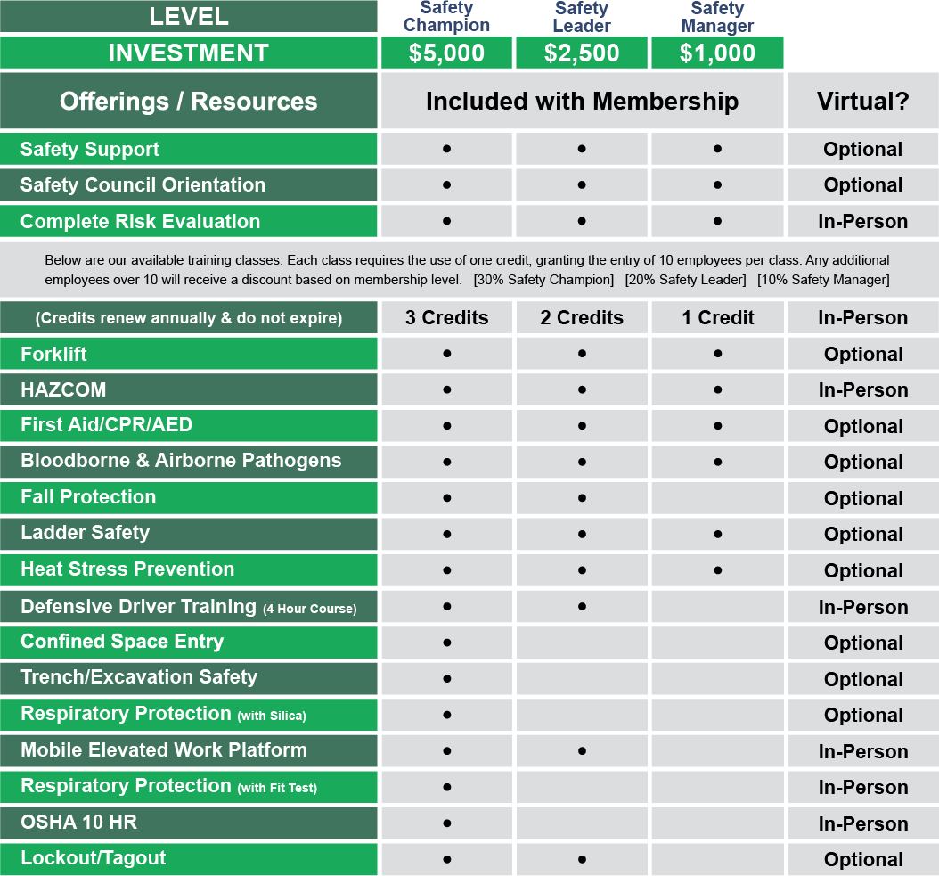
Let the Safety Council Serve as Your Safety Department with New Membership Program
Just Launched!

Slide 6
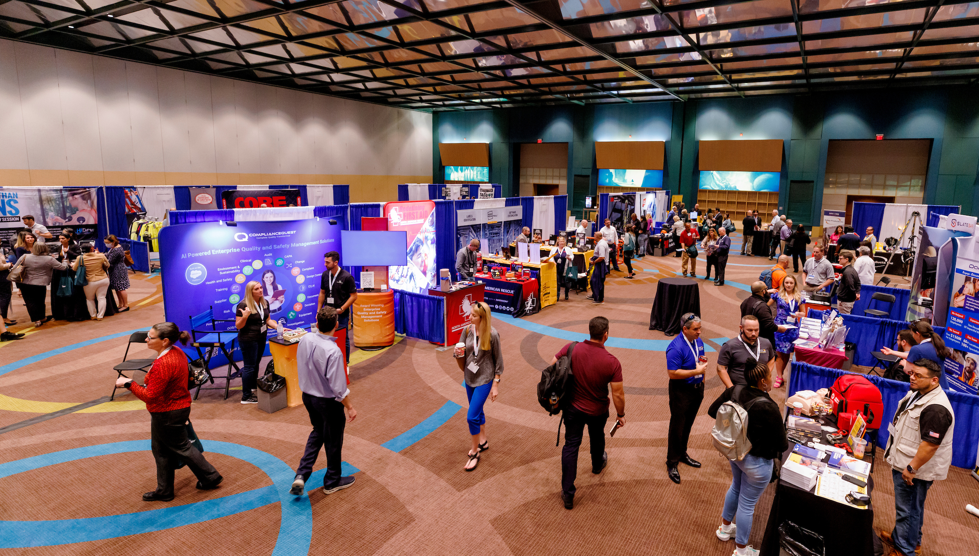
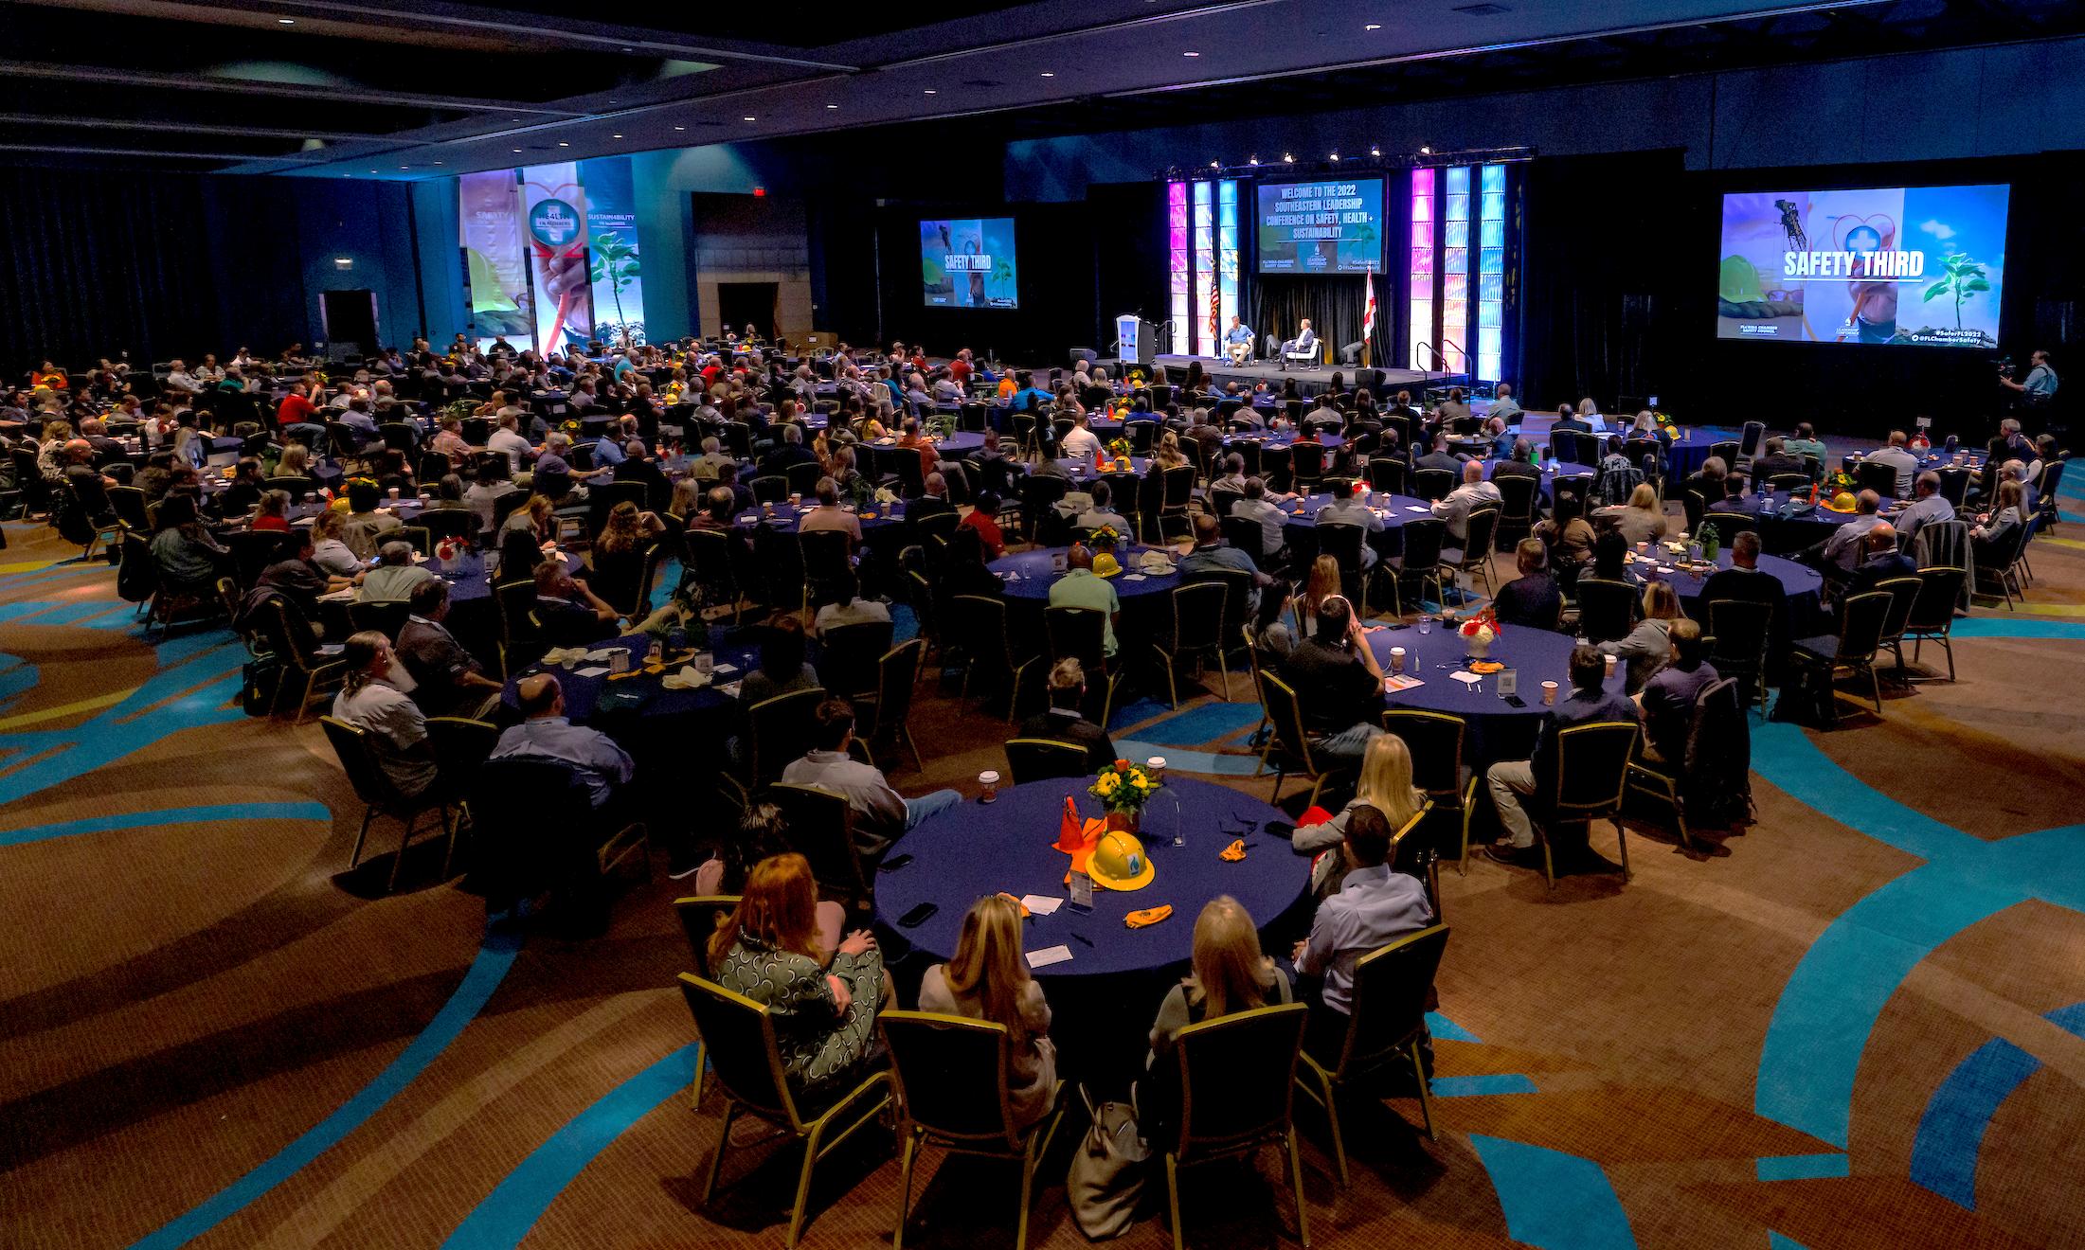
SAVE THE DATE
2023 Southeastern Leadership Conference on Safety, Health + Sustainability
May 10, 2023
Evening Opening Ceremonies & Welcome Reception
May 11 - 12, 2023
Official Conference Program
At Disney’s Contemporary Resort

Slide 7
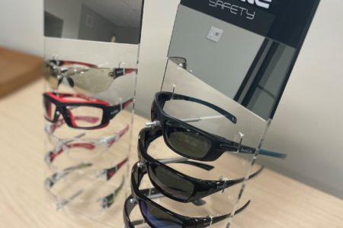
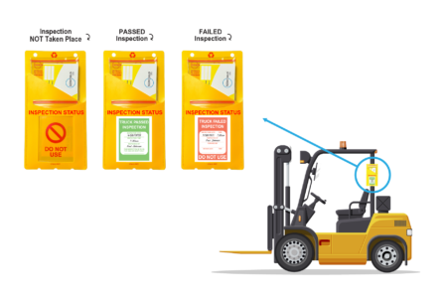
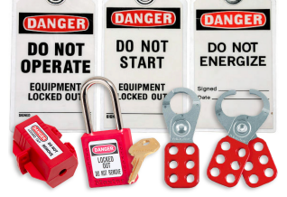
Shop our Growing Collection of Safety Supplies!
Protective Eyewear
Fall Protection Equipment
Worksite Apparel
Scan QR Code to Shop Now
Inspection Solution, Visitor Management and Signage
Lockout/Tagout Supplies

Slide 8
Effectively Handling Safety Risk Takers from a Management and Legal Perspective
Edwin G. Foulke
Former Head of OSHA & Current Partner Fisher Phillips, Florida Chamber Safety Council Advisory Board member

Slide 9
Effectively Handling Safety Risk Takers from a Management and Legal Perspective
Florida Chamber Safety Council
December 7, 2022
Presented by: Edwin G. Foulke Phone: (404) 240-4273 | Email: efoulke@fisherphillips.com

Slide 10
Thank You For Your Commitment To Safety
“Winning is not a sometime thing, it is an all-time thing.”
~ Vince Lombardi
So Is Safety!

Slide 11
Safety Is A Personal Decision

Slide 12
Workplace Injuries
What is behind most workplace injuries?
A lack of safety training
Poor equipment, policies, or systems
Ignorance
Inattention to risks

Slide 13
Safety Issues: What were they thinking?

Slide 14
Perceived Risk Levels
An individual’s perception as it relates to a particular job or task:
Ability to determine risks associated with the individual’s definition of his/her experience, history, training & communication, amount of control individual feels they have, …to the criteria they use to judge the situation.

Slide 15
Safety = Personal
Safety is something that’s personal – it involves an individual
Making a conscious decision to work safely in the workplace or at home.

Slide 16
Safety Challenges
Attitudes
Competing Priorities
Hazard Awareness

Slide 17
The Four A’s of Safety
Attitudes
Awareness
Action
Accountability

Slide 18
Attitudes
It won’t happen to me!
I’ve been doing this job for 15 years ….
I’m CAREFUL!
I don’t want to get (someone) in trouble!

Slide 19
Safety As A Value
Safety part of your employee’s character
Think about safety
Talk about safety
Work safely
Safety as a habit

Slide 20
Safety Awareness
Why develop a sense of safety awareness?
Without it, employees will not:
Wear their PPE, or wear it properly
Be aware of the potential for injury or illness
Observe simple rules (such as good housekeeping)

Slide 21
Safety As A Value
Without safety awareness employees
may think about:
- The next day’s schedule,
- Mowing the lawn,
- Evening activities
Anything but safety.

Slide 22
Human Factors and Safety
The following human factors are common causes of incidents:
Memory – Memory lapse may occur at any time
Judgement and reasoning power – May be reduced due to many factors
Attention – Failure to remain attentive or lack of attention
Delayed or false sensation of the sensory organs – Failed senses that could otherwise stimulate a response to avoid the incident

Slide 23
Prevention Measures
Incidents that are caused due to human (personal) factors may be prevented or reduced by the following preventative measures:
Training and skill development
Education and awareness
Supervision, monitoring and controlling
Feedback and reports
Frequent inspections and audits

Slide 24
Performance Management In Dealing With Safety Risk Takers
Performance management is an ever increasingly important tool of employee relations
Gone are the days of relying on the “at-will” clause and here are the days of acknowledging that coaching and counseling prior to termination has numerous benefits
Decreases transitional cost and time for replacement
Increases employee engagement; and
Reduces risk assessment in termination cases.

Slide 25
Traits of An Effective Manager
Addresses and resolves problems as they occur
Identifies employees who need training, support, or direction
Is accessible and approachable
True open-door policy
Follows up with employees
Accurately documents issues and discussions

Slide 26
Overview
Getting The Right People
Setting Expectations
Performance Coaching
Corrective Action
Releasing
Safety Risk Takers

Slide 27
Step 1: Getting The Right People
Recruiting
Screening
Interviewing
Hiring
This also applies to internal promotions and transfers.

Slide 28
Step 2: Making Safety Expectations Clear
Sources of information to employees regarding the company’s safety expectations
Orientation
New hire
Department-specific onboarding
Employee handbook
Other company safety policies and procedures
Written job description to include safety
Offer letter
Safety training
Quarterly performance discussions
Regular 1:1 meetings (at least once a month)

Slide 29
Step 3: Safety Performance Management
Immediate
Personalized
Specific

Slide 30
Ways to Provide Performance Management of Risk Takers
Immediate Review of Unsafe Behaviors or Practices
Quarterly or Annual Performance Evaluations
Weekly or Monthly Status Reports
Informal Coaching and Mentoring
Corrective Action Notices
Disciplinary Action

Slide 31
Methods of Corrective Actions
Methods
Always work with your HR Department to draft and deliver performance counseling.
Verbal
E-mail/Text
Written

Slide 32
Engaging In and Documenting Corrective Action
No matter the method of delivery, keep your performance management “C.L.E.A.N.” and “N.E.A.T.”

Slide 33
The “C.L.E.A.N.” Doctrine
Consider facts behind discipline
Learn what managers, witnesses, and documents have to say
Evaluate what disciplinary action has been taken in the past
Analyze risk
Narrow down potential options and decide

Slide 34
The “C.L.E.A.N.” Doctrine
Consider the facts behind potential discipline
What happened?
Who witnessed it?
What documents exist?
How did the issue come to your attention?

Slide 35
The “C.L.E.A.N.” Doctrine
Learn what managers, witnesses, and documents have to say
Collect information from managers and review relevant information
If appropriate, talk to witnesses who may have seen the event or have knowledge about the issue (other managers about employee’s safety performance)
Talk to the employee and get his/her side of the story

Slide 36
The “C.L.E.A.N.” Doctrine
Evaluate what disciplinary action has been taken in the past
Department, facility, and potentially company-wide analysis
How has this manager reacted to similar situations in the past
“Didn’t we only issue a verbal warning to Sally last month …?”

Slide 37
The “C.L.E.A.N.” Doctrine
Analyze risk
Who is the manager?
Who is the employee?
What support is available for the decision?
What protected safety category does the employee fall into?
Whistleblower
Recent complaints?
Other issues that could come up because of discipline (e.g., EEOC, wage and hour)?

Slide 38
The “C.L.E.A.N.” Doctrine
Narrow down potential options and decide
Training
Policy acknowledgement
Verbal warning
Written warning
Suspension
Termination
Severance?
How are we treating similarly situated individuals?

Slide 39
The “N.E.A.T.” Doctrine
Notice
Explanation of deficiencies
Assistance in how to improve performance
Time for improvement

Slide 40
Verbal Counseling
When possible refer to training materials, procedures or employee handbook
Creates a blueprint for more formal counseling
1
2
3
Don’t allow it to go on for months

Slide 41
Written Counseling
Detail what they did wrong What, when, where, how and why
Refer to policies & procedures
Give deadline to correct problem
Effective immediately and going forward

Slide 42
Written Counseling
Meet with the employee to review safety evaluation and issues as well as expectations for improved safe behaviour.
Follow through by providing further counselling, disciplining or termination if necessary.
Include language:
“Repetition of this conduct, failure to follow any of our normal work rules or rules of conduct, or to meet our standards of performance will result in further disciplinary action, up to and including termination of your employment.”
.

Slide 43
Documentation Is Critical
Juries will only believe you if you put it in writing
When its just your word against theirs, you lose most of the time

Slide 44
Step 4: Releasing of Safety Risk Takers
Last resort is termination of employment
Must be set up properly
Documentation is critical
Must show that employee has been advised of safety rule violations and/or poor safety performance in the past

Slide 45
Termination Action Plan
Identify the “critical incident”
Review every decision before acting
N.E.A.T and C.L.E.A.N principles
Pre-termination review with HR Department
Work with your HR Department to…
Get employee’s perspective
Be consistent across the organization and with similar prior unsafe acts or safety rule violations
Document facts – leave emotion out of it
Prepare the discharge notice with your HR Department

Slide 46
High Risk Terminations
Lack of documentation
Long-term employees
Problem employees
Protected categories
Timing problems – Employee back from recent LOA
No “trigger” event

Slide 47
Common Red Flags
Untrue reasons for termination
Vague/unsubstantiated reasons for termination
Not giving any reason for termination
Rush to judgement
Termination for single incident of minor safety rules
Misconduct termination when others engage in same safety rule violations and/or unsafe practice/behavior without consequence
Termination of someone currently on, or who just returned from, a leave of absence
Retaliation/whistleblower

Slide 48
Drafting the Termination Notice
Track warning language
Refer to previous warnings and use same language
Be truthful
Don’t sugarcoat it
Avoid defamation
Be complete
What you leave out may be the very reason you want to use in court
Avoid vague language

Slide 49
FINAL QUESTIONS
“
Presented by: Edwin G. Foulke, Jr.
Phone: (404) 240-4273 Email: efoulke@fisherphillips.com

Slide 50
Fisher Phillips LLP
is dedicated exclusively to representing employers in the practice of employment, labor, benefits, OSHA, and immigration law and related litigation.
THESE MATERIALS AND THE INFORMATION PROVIDED DURING THE PROGRAM SHOULD NOT BE CONSTRUED AS LEGAL ADVICE OR AS CRITICAL OF THE CURRENT OR PAST ADMINISTRATIONS.

Slide 51
Thank You!
Presented by: Edwin G. Foulke, Jr.
Phone: (404) 240-4273 Email: efoulke@fisherphillips.com

Slide 52
Closing Remarks
Jason Mozo, J. D.
Executive Director
Florida Chamber Safety Council JMozo@FlChamber.com
(850) 521-1237

Slide 53
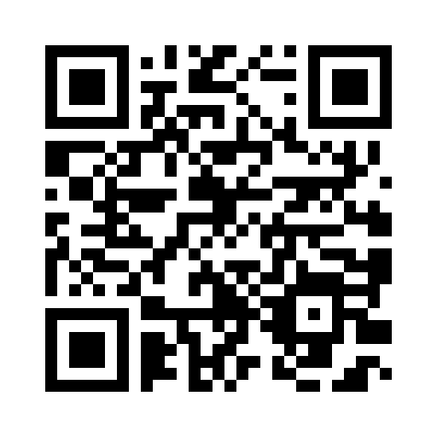
Save 25% On Ladder Safety Courses in December
Scan the QR Code to Book a Training
Topics Include:
Proper Selection
Electrical Hazards
Portable & Extension Ladders
3-Points of Contact
Ladder Inspection
Safe Work Practices
*Participants receive a course completion certificate and will earn .25 CEUs from the Florida Chamber Safety Council

